Slide 1


Advanced Computer Architecture Fall 2019
Hamed Farbeh
farbeh@aut.ac.ir
Department of Computer Engineering
Amirkabir University of Technology
Lecture 5

Slide 2
Copyright Notice
Lectures adopted from
Computer Architecture: A Quantitative Approach, 5th edition, John L. Hennessy,‎ David A. Patterson, MK pub., 2019
Advanced Computer Architecture-Spring 2018, AUT, Tehran, Iran

Slide 3
Computer Architecture
A Quantitative Approach, Sixth Edition
Chapter 3
Instruction-Level Parallelism and Its Exploitation

Slide 4
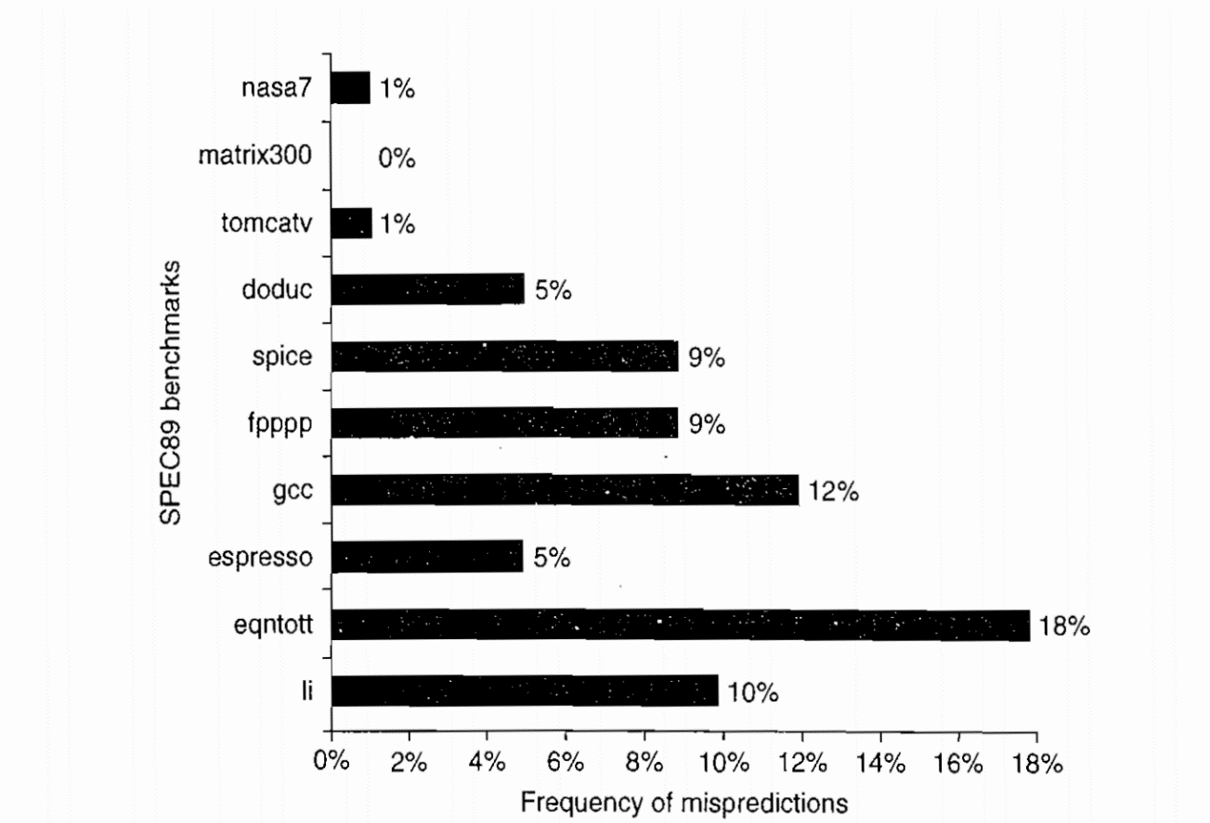
Branch Prediction
Branch Prediction
Static Branch Prediction
Compile-time branch prediction
Profiling information
Branches are highly biased toward taken or untaken

Slide 5
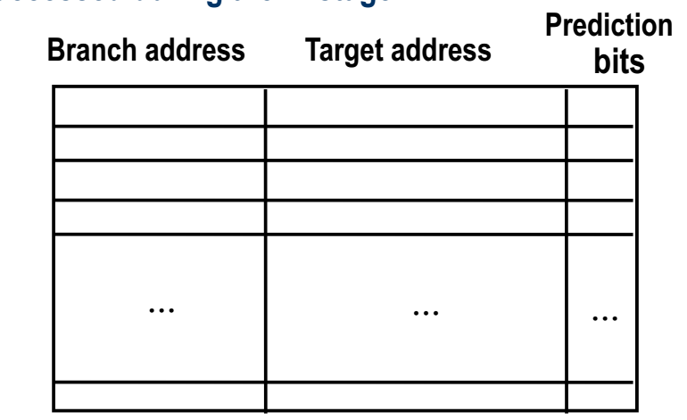
Dynamic Branch Prediction
Branch Prediction
Branch-Target Buffer (BTB)
Or Branch-Target Address Cache (BTAC)
The Branch Target Buffer (BTB) or Branch-Target Address Cache (BTAC) stores branch and jump addresses, their target addresses, and optionally prediction information.
The BTB is accessed during the IF stage

Slide 6
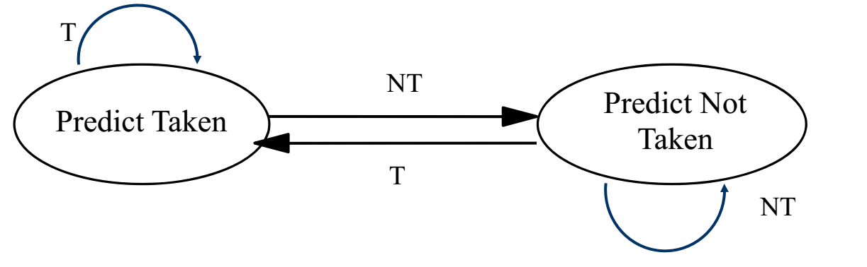
Dynamic Branch Prediction
Branch Prediction
One-bit predictor
For each branch:
Predict taken or not taken
If the prediction is wrong, change prediction

Slide 7
Dynamic Branch Prediction
Branch Prediction
One-bit predictor
A one-bit predictor correctly predicts a branch at the end of a loop iteration, as long as the loop does not exit.
In nested loops, a one-bit prediction scheme will cause two mispredictions for the inner loop:
One at the end of the loop, when the iteration exits the loop instead of looping again,
one when executing the first loop iteration, when it predicts exit instead of looping.
Such a double misprediction in nested loops is avoided by a two-bit predictor scheme.
Two-bit Prediction: A prediction must miss twice before it is changed when a two-bit prediction scheme is applied.

Slide 8
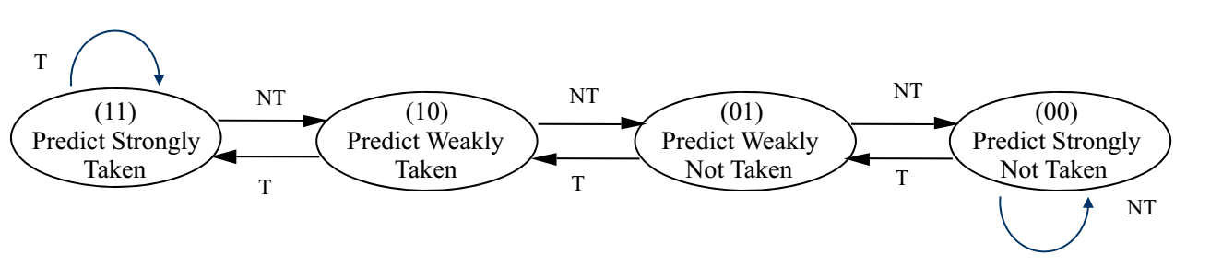
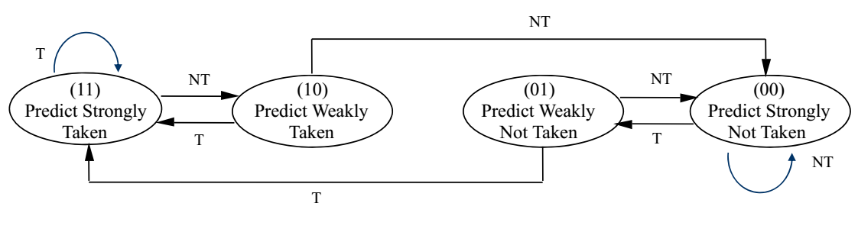
Dynamic Branch Prediction
Branch Prediction
Basic 2-bit predictor:
For each branch:
Predict taken or not taken
If the prediction is wrong two consecutive times, change prediction

Slide 9
Branch History Table
Mispredict because either:
Wrong guess for that branch
Got branch history of wrong branch when index the table
4096 entry table programs vary from 1% misprediction (nasa7, tomcatv) to 18% (eqntott), with spice at 9% and gcc at 12%,
4096 about as good as infinite table (in Alpha 21164)

Slide 10
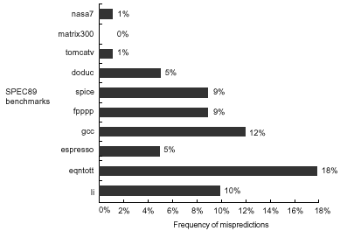
BHT Accuracy
4096 entry, two bit prediction

Slide 11
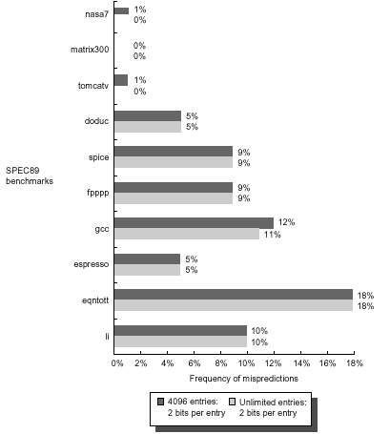
Unlimited Entries

Slide 12
Correlating Branches
Hypothesis: recent branches are correlated; that is, behavior of recently executed branches affects prediction of current branch
Idea: record m most recently executed branches as taken or not taken, and use that pattern to select the proper branch history table
In general, (m,n) predictor means record last m branches to select between 2^{m} history tables each with n-bit counters
Old 2-bit BHT is then a (0,2) predictor

Slide 13
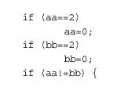
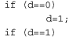
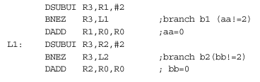
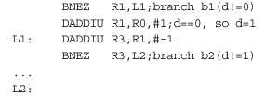
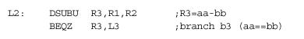
Examples
Code from eqntott from
SPEC92
b3 has correlation with b1, b2

Slide 14
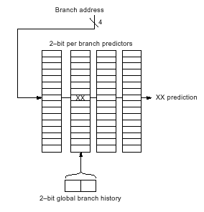
Correlating Branches
(2,2) predictor
The behavior of recent branches selects between, say, four predictions of next branch, updating just that prediction
Simple implementation:
global history can be stored in a shift register
Branch address is concatenated with global branch history and then indexed.

Slide 15
Number of Stored Bits
For an (m,n) predictor:
2^m * n * Number of prediction entries
Example:
2-bit predictor with 4096 entries:
2^0 * 2 * 4k = 8k
(2,2) predictor, how many entries to be 8k:
2^2 * 2 * x = 8k ➔ x = 1k

Slide 16
Accuracy of Different Schemes

Slide 17
Tournament Branch Predictor
Used in Alpha 21264: Track both “local” and global history
Intended for mixed types of applications
Global history: T/NT history of past k branches,
e.g. 0 1 0 1 0 1 (NT T NT T NT T)
Global predictor uses the most recent branch history to index the predictor
Local predictor uses the address of the branch as the index
PC
Local
Predictor
Global
Predictor
Choice
Predictor
mux
Global
history
NT/T
Notes:
Multi-level predictor
Tournament: competition

Slide 18
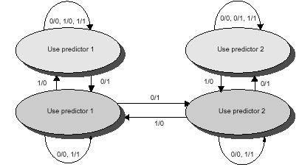
Predictor Select
Notes:
0/0 means both predictors were wrong. 1/0 means predictor 1 was right and predictor 2 was wrong

Slide 19
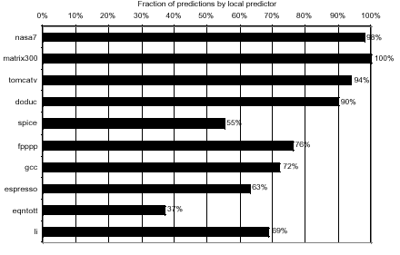
Local Predictor Percentage

Slide 20
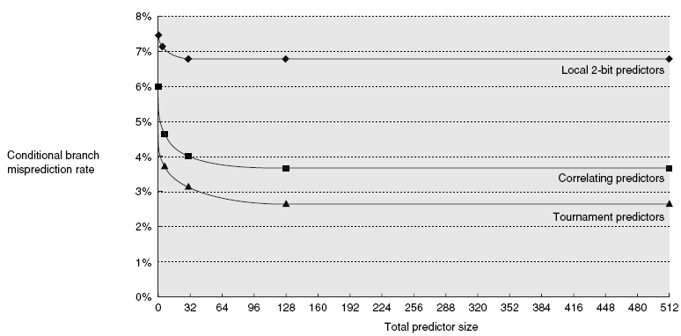
Performance Comparison

